Slide 1

Flutter

Slide 2
Flutter
Buttons
TextFormField

Slide 3
Button Widget

Slide 4
Button Widget

Slide 5
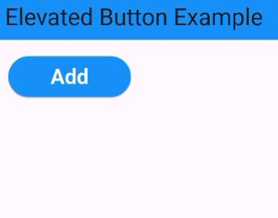
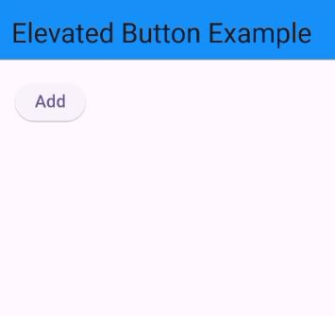
Elevated Button
ElevatedButton(
onPressed:( ){
} ,
child: Text('Add'),
style: ElevatedButton.styleFrom(
backgroundColor: Colors.blue,
foregroundColor: Colors.white,
textStyle: TextStyle(fontSize: 20,fontWeight: FontWeight.bold),
minimumSize: Size(150, 50)
),
)

Slide 6
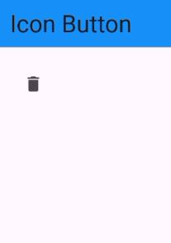
Icon Button
IconButton(
onPressed: (){ } ,
icon: Icon(Icons.delete)
)

Slide 7
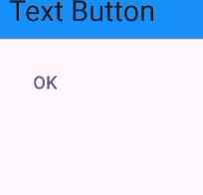
Text Button
TextButton(
onPressed: (){
},
child: Text('OK')
)

Slide 8
Text Button
TextButton(
onPressed: (){
},
child: Text('OK')
)

Slide 9
Text Form Field Widget

Slide 10
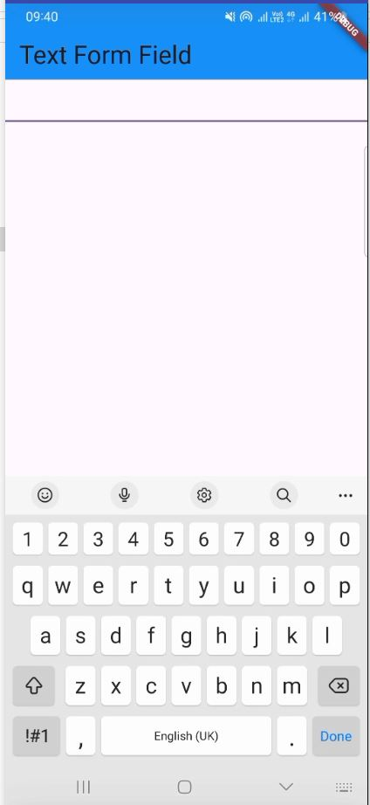
Text Button
TextFormField(
)

Slide 11
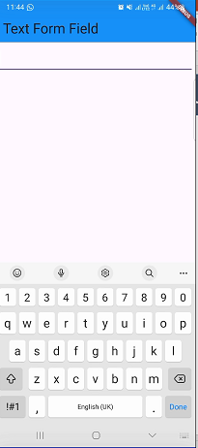
Text Button
TextFormField(
)

Slide 12
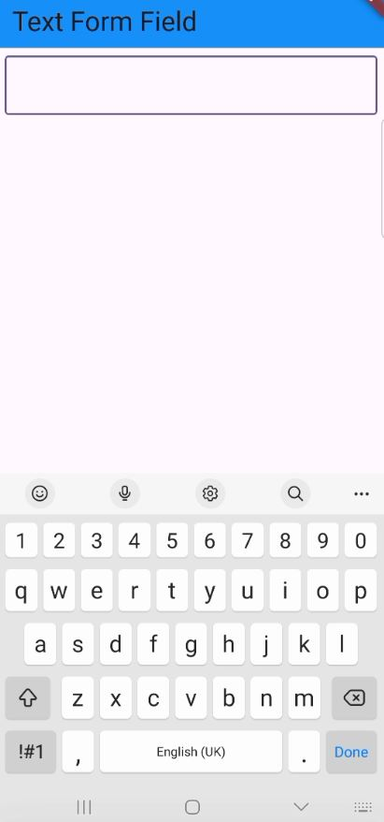
Text Button
TextFormField(
decoration: InputDecoration(
border: OutlineInputBorder()
),
)

Slide 13
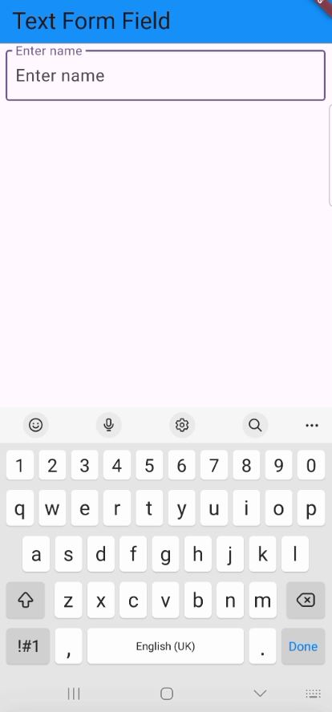
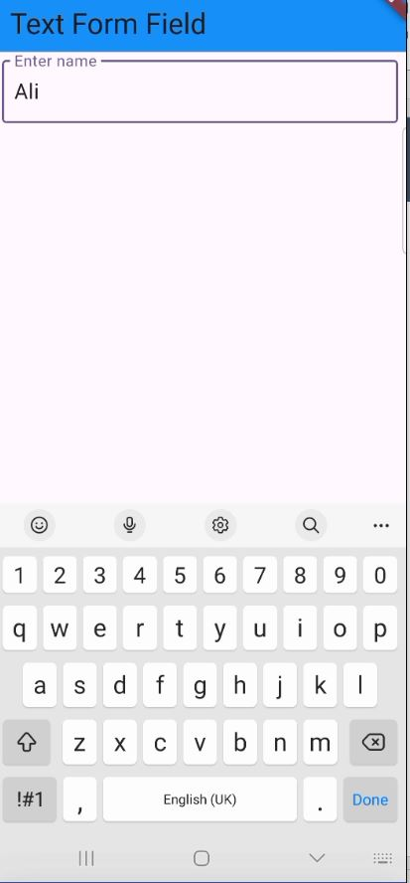
Text Button
TextFormField(
decoration: InputDecoration(
border: OutlineInputBorder(),
hintText: 'Enter name',
labelText: 'Enter name'
),
)

Slide 14
Text Button
TextEditingController nameController=TextEditingController();
TextFormField(
controller: nameController,
decoration: InputDecoration(
border: OutlineInputBorder(),
hintText: 'Enter name',
labelText: 'Enter name'
),
)
String name=nameController.text;
nameController.text="Amjad";

